Slide 1

Energy Usage Tracking and Automated Billing
An in-depth exploration of energy tracking systems, highlighting their role in enhancing efficiency and automating billing processes for cost-effective energy management.
Pandeti Sai Siva Jahnavi(192124025)
N. Sai Varshitha ( 192111074)

Slide 2
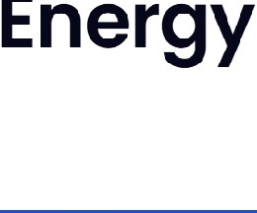
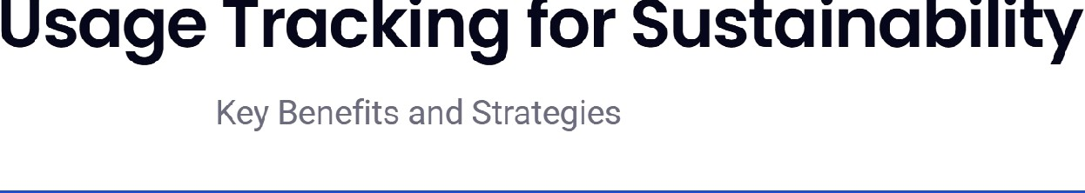
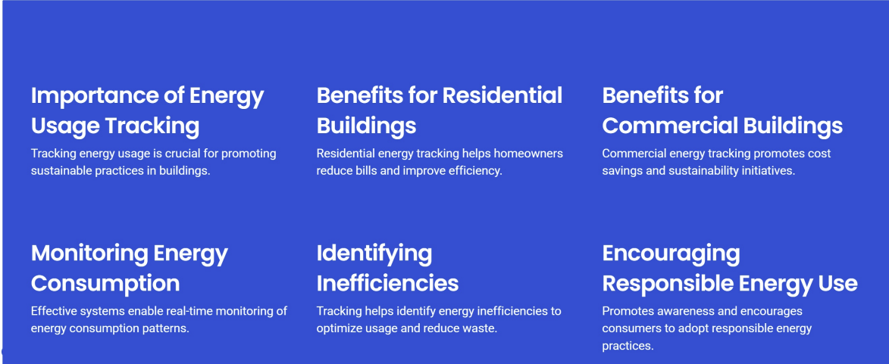

Slide 3
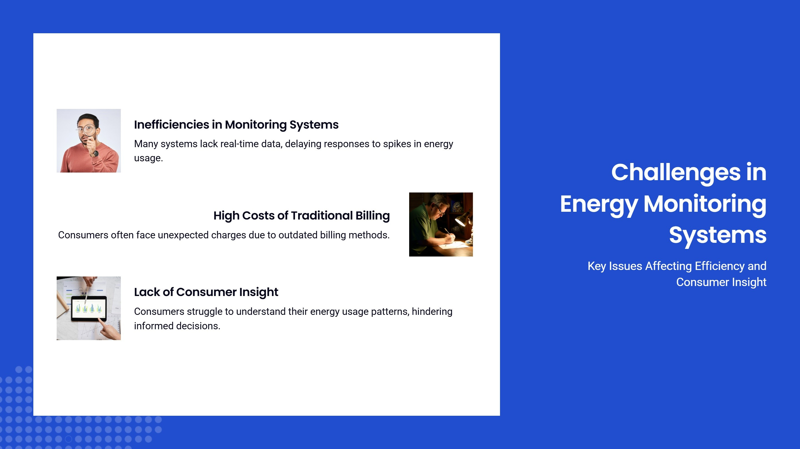



Slide 4
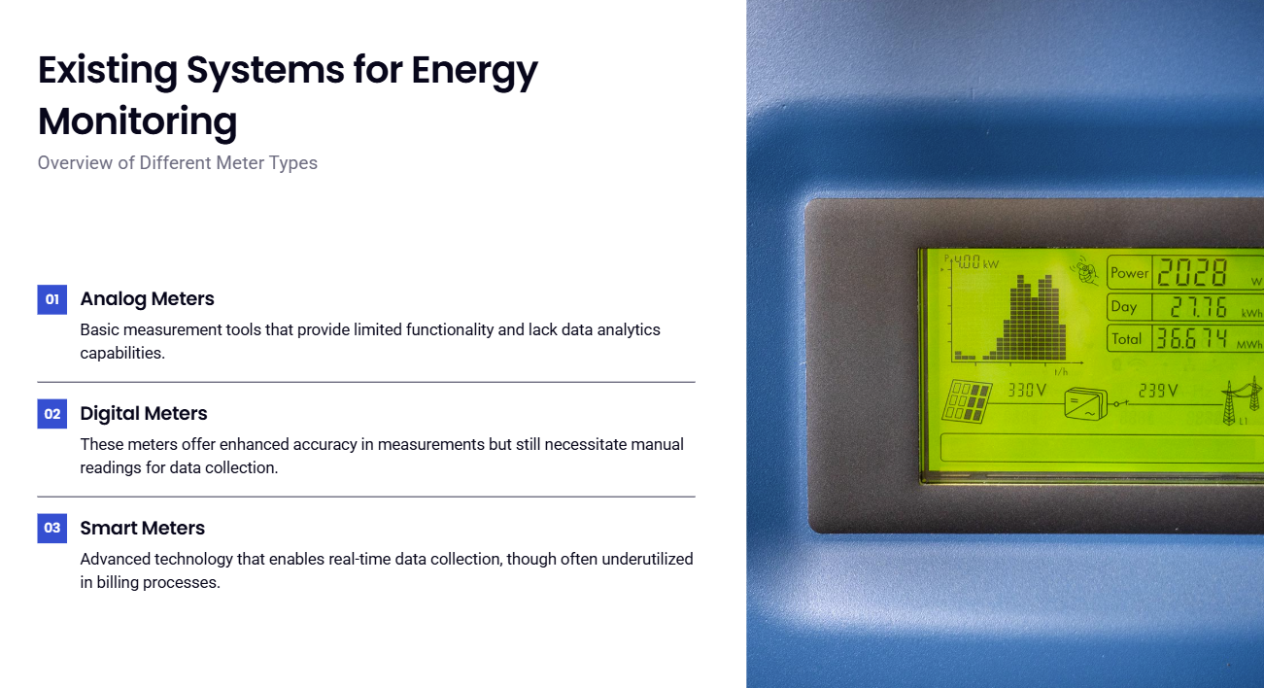

Slide 5
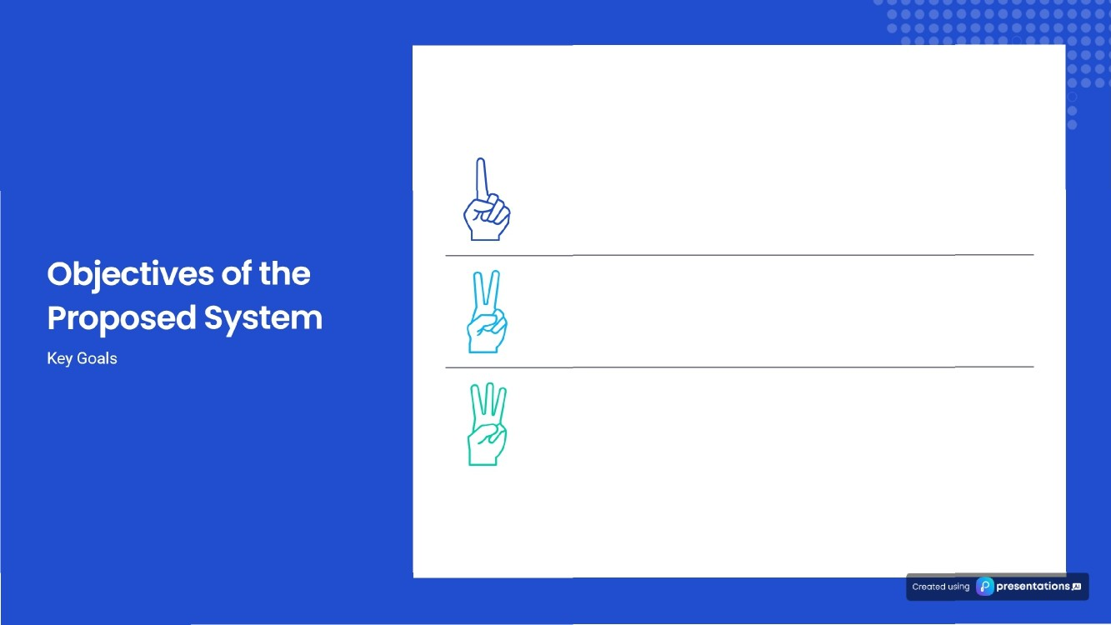

Accurate Tracking
Provide precise data on energy consumption, enabling better decision-making
Automated Billing
Streamline billing processes to reduce errors and improve customer satisfaction.
Usage Forecasting
Utilize historical data to predict future energy usage and inform energy management strategies.

Slide 6
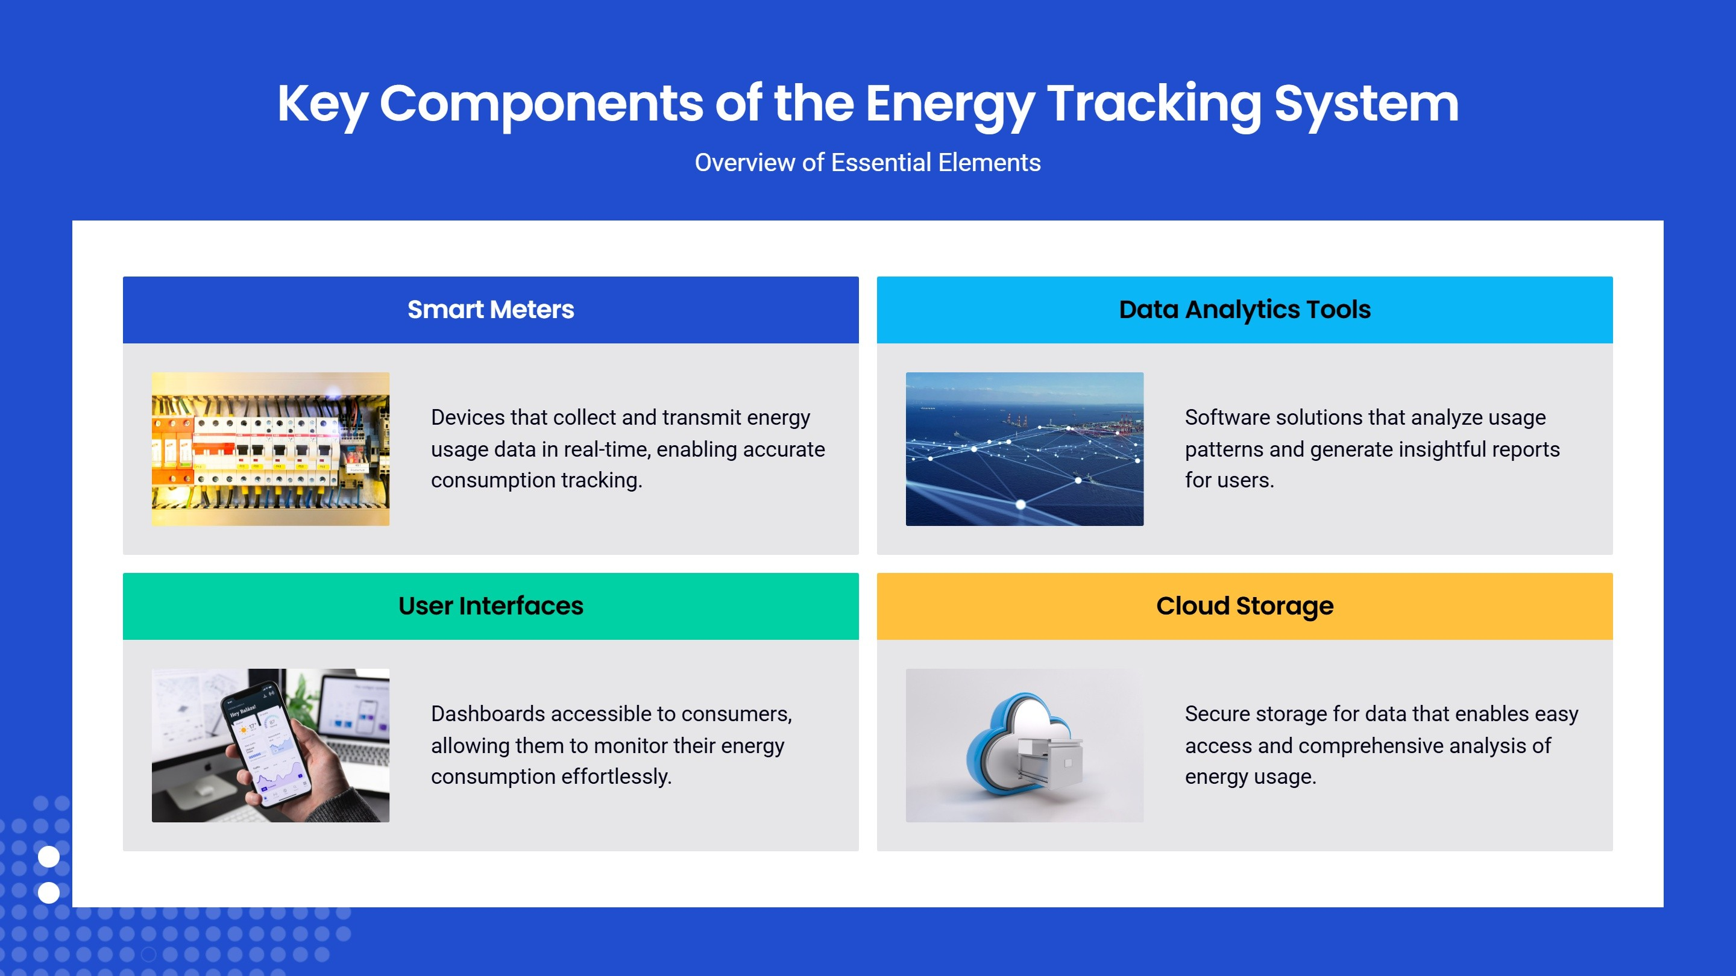


Slide 7
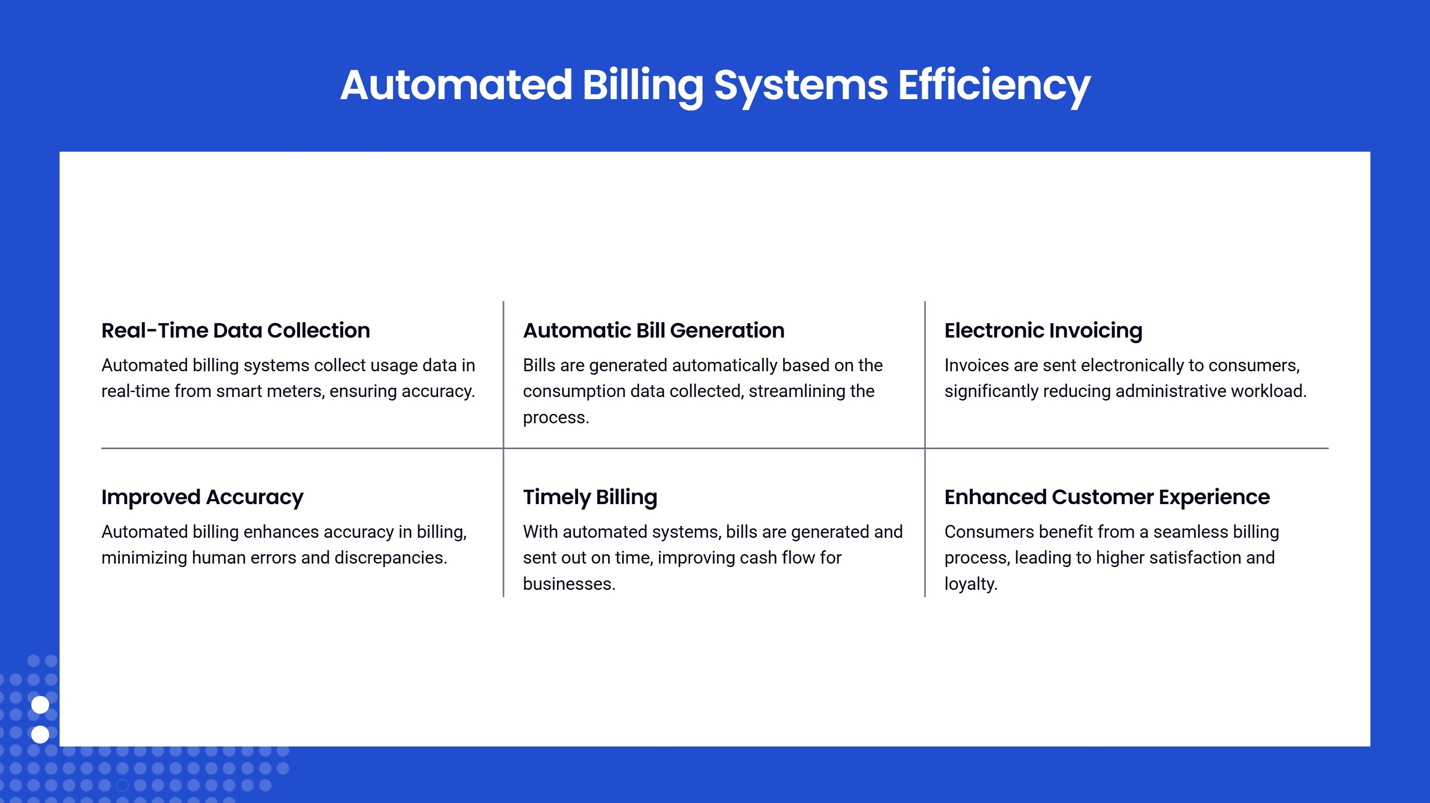

Slide 8
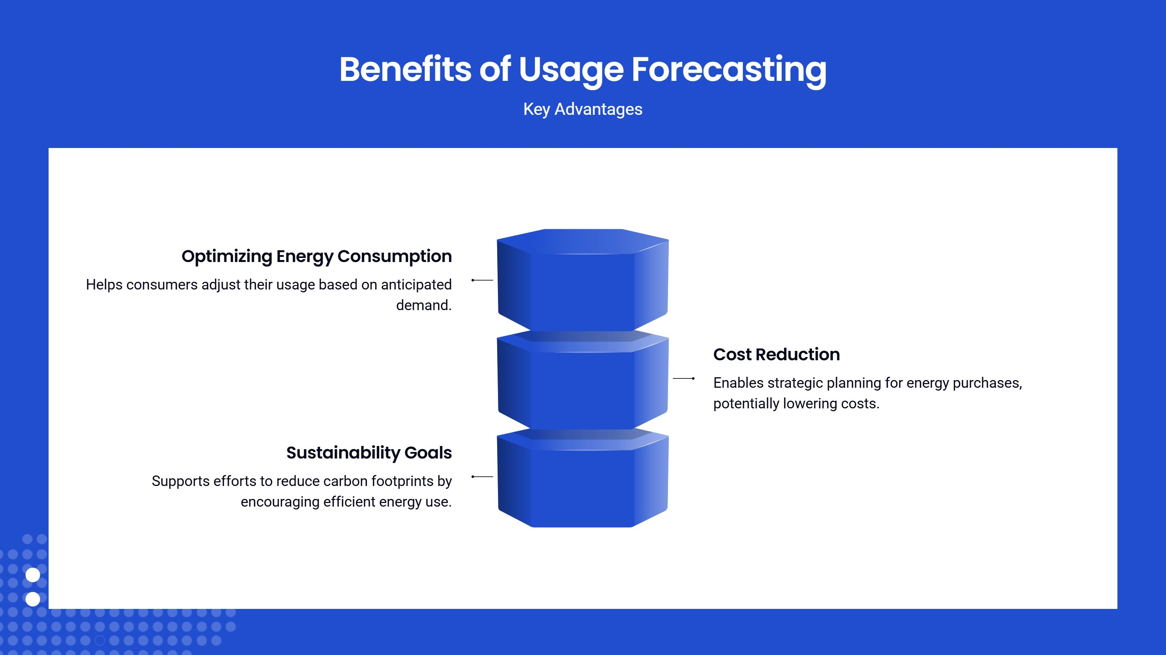

Slide 9
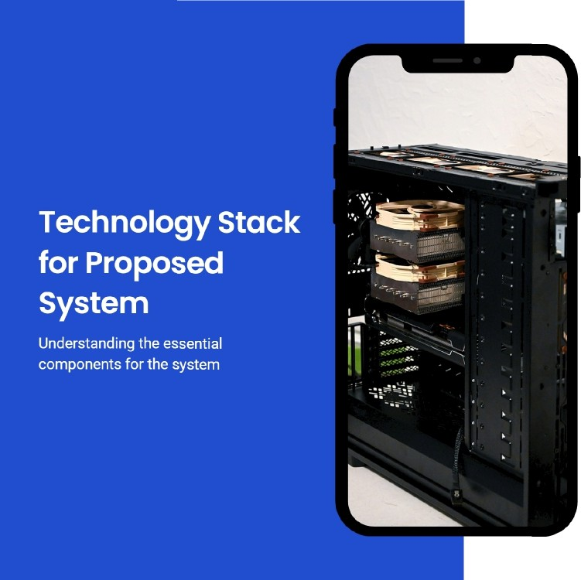





Software Requirements
Essential software includes data analytics platforms and billing management systems for efficient operation.
Hardware Components
The hardware comprises smart meters and communication devices crucial for accurate data collection.
Networking Infrastructure
Secure internet connections are vital for reliable data transmission and cloud access.
’œn'eó'1°nç preseutotions

Slide 10
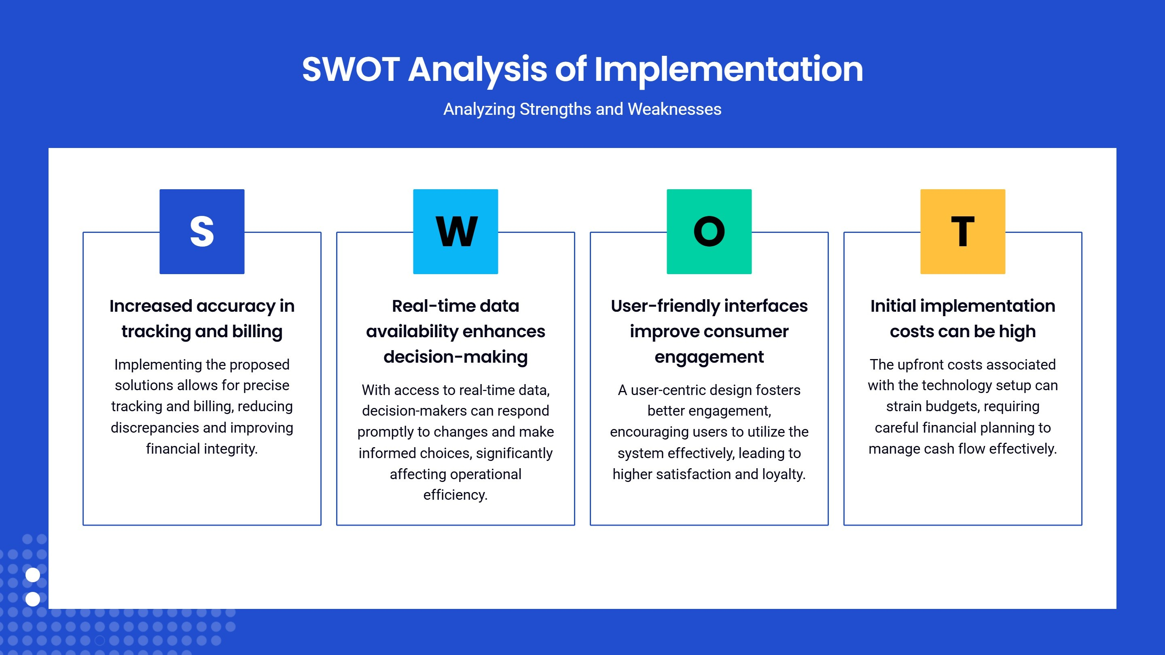

Slide 11
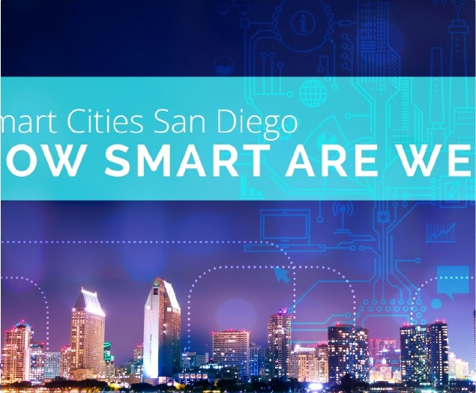
Cose Studies on Energy Trocking Systems
Demonstrating Effectiveness
City of Son Diego's Smart Meters
Implemented smart meters leading to a 20% reduction in energy consumption.
Green Building Initiative
Utilized data analyics to optimize energy use in commercial buildings, achieving significant cost savings.

Slide 12
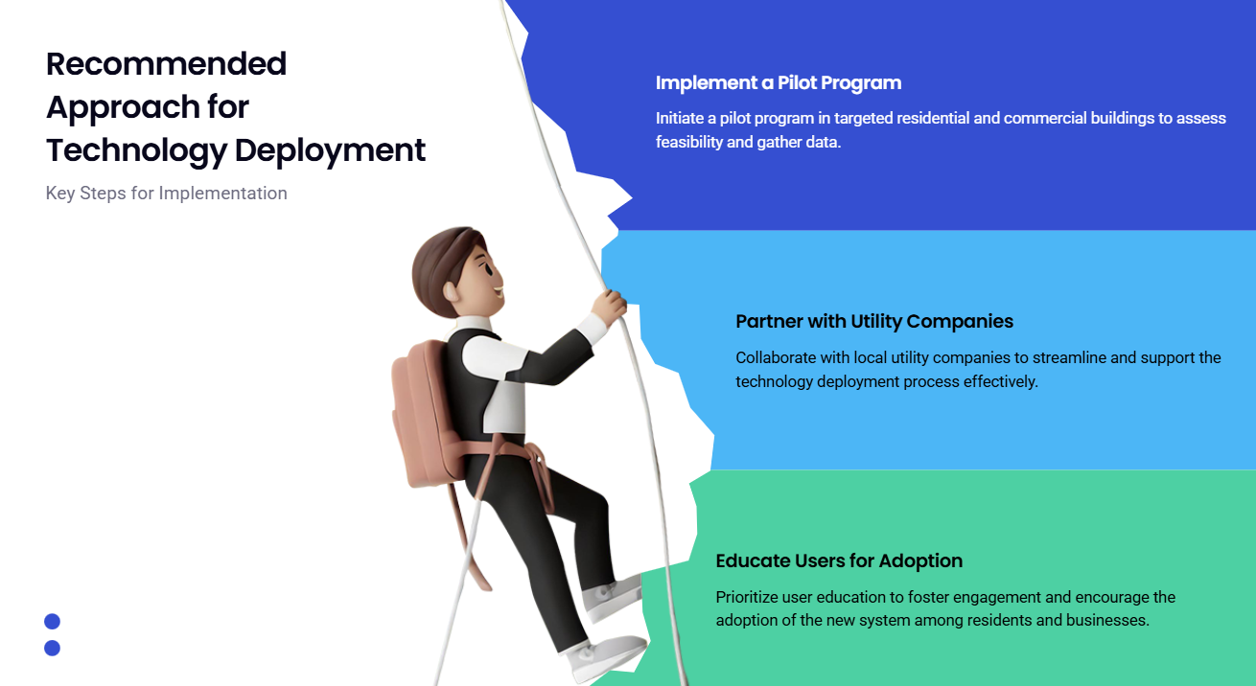

Slide 13
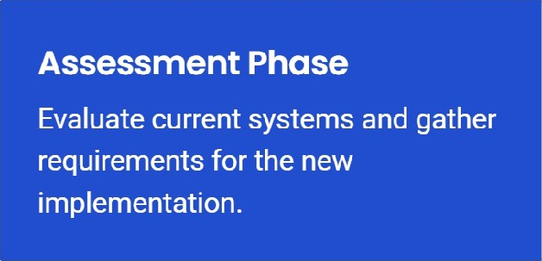
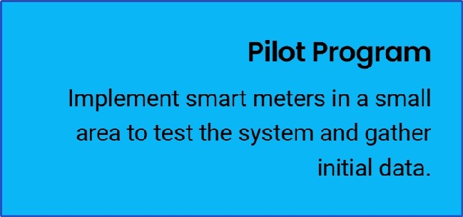
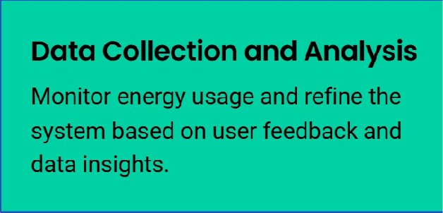
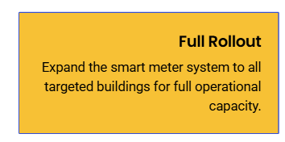
Month 1-2
Month 3-6
Implementation Plan Timeline
Phases of Implementation Over 1 2 Months
Month 7-9

Slide 14
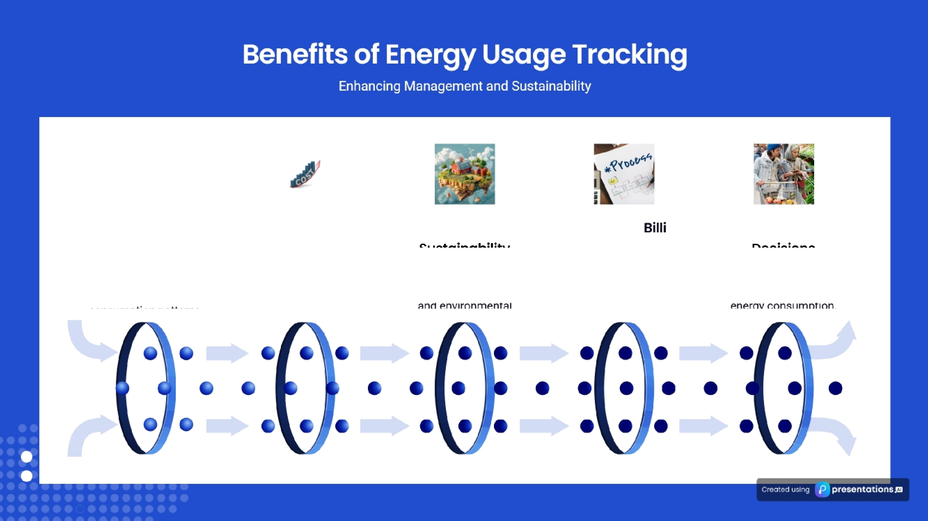
Enhanced Energy Monooement Implementing tracking systems allows for better monitoring of energy
Cost Reduction Efficient energy usage leads to significant cost savings for both consumers and
businesses.
Automoted ng Automation simplifies invoicing and payments, enhancing the user experience and reducing
Informed Consumer
Access to usage data enables consumers to make smarter choices about their
Reducing energy consumption contributes to a smaller carbon footprint

Slide 15


